Slide 1
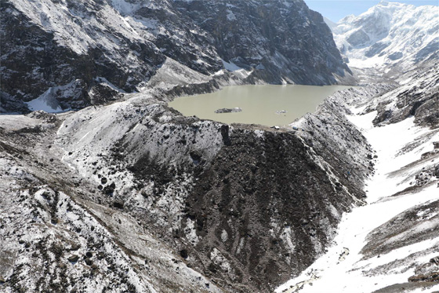
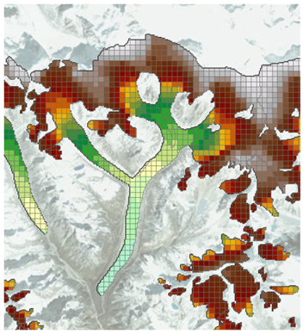

Improvement of the SPHY Model Glacier Module and its Application in the Tamakoshi River Basin, Nepal
W. Terink and W.W. Immerzeel
November 2017
info@futurewater.nl

Slide 2
Overview existing models for glacier dynamics
Volume-Area scaling (Bahr, 1997)
Assumes same non-linear relation between V and A
Lumped
Large scale lumped (Lutz et al., 2013)
Assumes idealized hypsometry for all glaciers
Distributed
dH parametrization (Huss et al., 2010)
Requires multiple DEMs per glacier to assess
Weertman sliding (Immerzeel et al., 2011, 2013; Shea et al., 2015)
Only feasible at high resolution ( < 100 m)
Ignores viscous deformation
Initial conditions
Shallow ice approximation (Rowan et al., 2015)
Only feasible at high resolution
Initial conditions
Notes:
“There is a need for a medium to large scale glacier dynamics model that can be integrated in distributed hydrological model that is (i) scale independent, (ii) incorporates mass transport from the accumulation to the ablation zone (iii) can account for the effects of climate changes on glacier retreat, (iv) can be applied in data scarce areas”

Slide 3
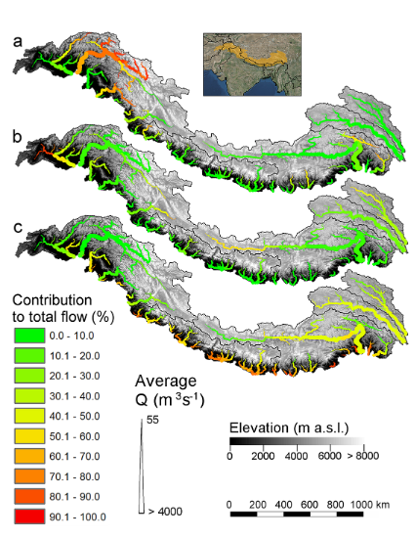
Introduction SPHY model
Published in GMD (Terink et al., 2015)
Calculates soil-water and cryosphere processes
on a cell-by-cell basis
Spatially distributed
Sub-grid variability (fractional coverage)
Modular approach
Applied in several studies in the
Hindu Kush Himalayan region, Chile, and Africa
Lutz et al. 2014
Terink, W., Lutz, A. F., Simons, G. W. H., Immerzeel, W. W., and Droogers, P.: SPHY v2.0: Spatial Processes in HYdrology, Geosci. Model Dev., 8, 2009-2034, doi:10.5194/gmd-8-2009-2015, 2015.
Lutz, A. F., Immerzeel, W. W., Shrestha, A. B., and Bierkens, M. F. P.: Consistent increase in High Asia’s runoff due to increasing glacier melt and precipitation, Nature Climate Change, 4, 587–592, doi:10.1038/nclimate2237, 2014.

Slide 4
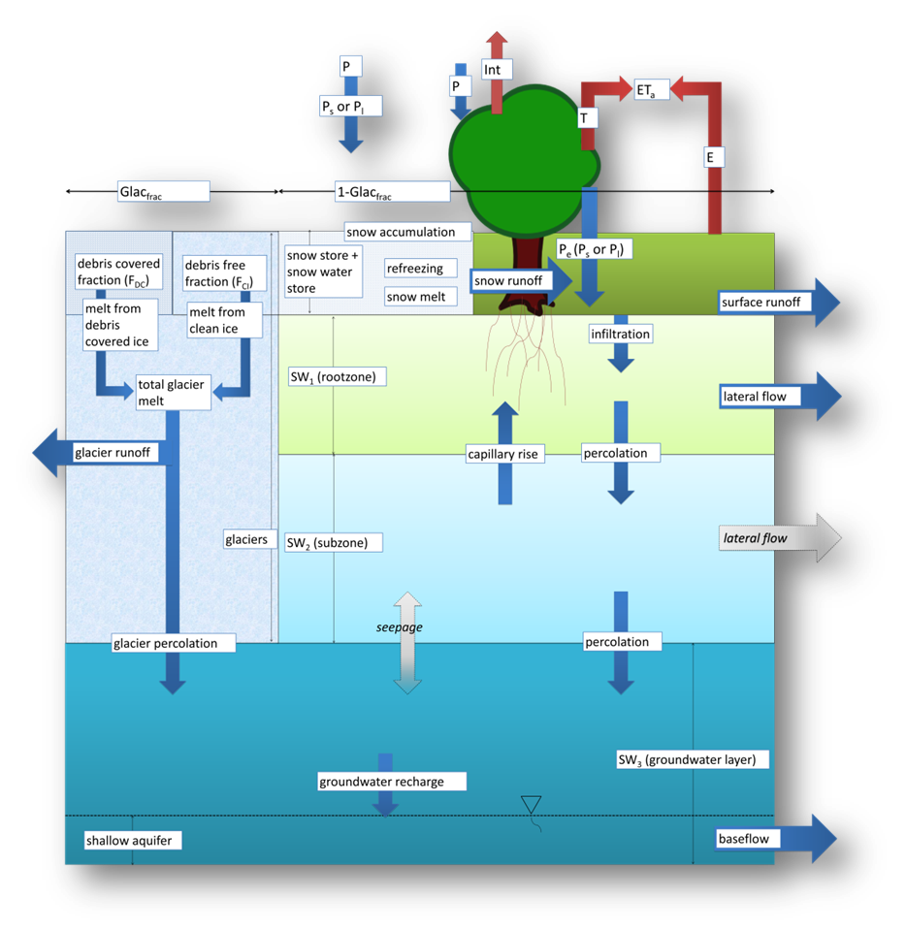
Current SPHY model glacier module
Glaciers are implemented as a fixed mass generating glacier melt using a degree day factor
Rainfall on the glacier is not taken into account, and needs to be corrected for as a pre-processing step
Snowfall, accumulation of snow, and snow melt is not taken into account
Thus:
Not mass conserving
No ice redistribution

Slide 5
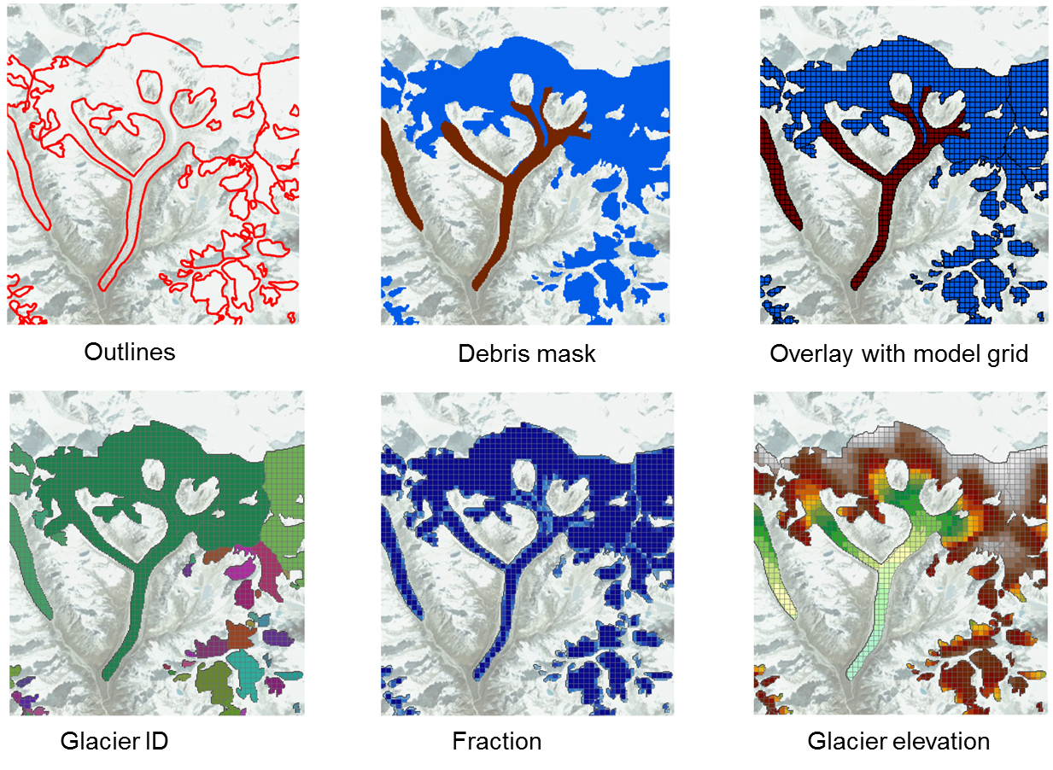
Improved glacier module: mass conserving

Slide 6
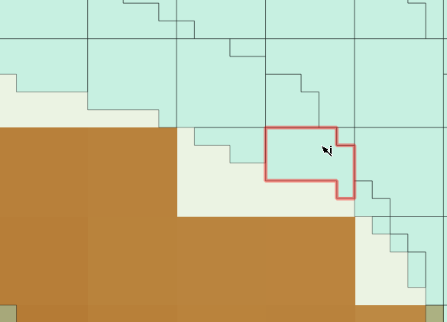
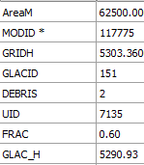
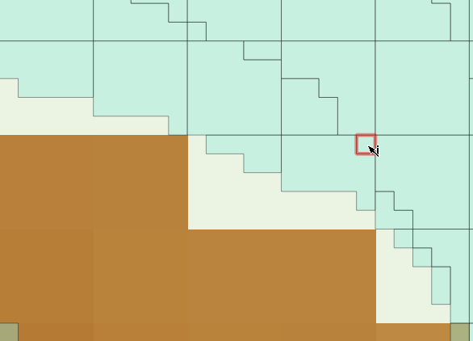
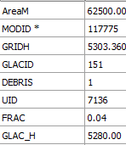
Improved glacier module: mass conserving
Model resolution: 250 x 250 m
UID = unique combination of model cell ID and glacier ID
Distinction between debris and debris-free
Temperature lapsed to glacier elevation within a cell (monthly lapse rates)
Taking into account snow and rain on the glacier
Melt rates adapt based on the presence of a dynamic snow pack (first snow, then glacier)
Glacier mass balance for each glacier in maintained –> mass conserving

Slide 7
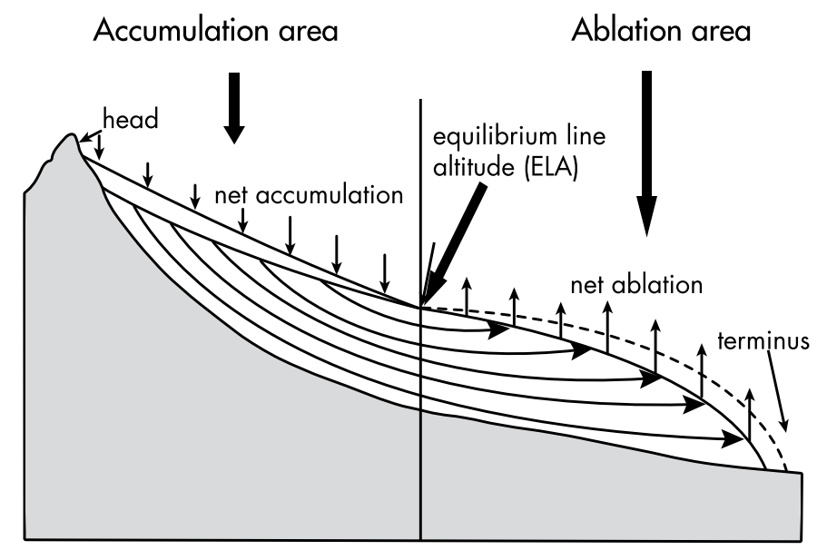
Improved glacier module: ice redistribution
Initial ice thickness (Glaptop2 (Frey et al., 2014; Linsbauer et al., 2015)
Ice redistribution calculated at end of hydrological year
Only redistribution if total glacier mass balance is negative
Accumulated mass is redistributed over ablation UIDs according to ice volume distribution

Slide 8
Tamakoshi River Basin: forcing and calibration
Observations:
6 precipitation stations
3 temperature stations
2 discharge stations
Reference data set:
Corrected WFDEI (5 km) 1981-2010 (Lutz and Immerzeel, 2015)
Bias correction:
Temperature: mean and standard deviation (Terink et al., 2010)
Precipitation: mean
Calibration (2000-2009):
10-year average glacier mass balance (-380 mm/year) (Kääb et al. 2015)
River discharge

Slide 9
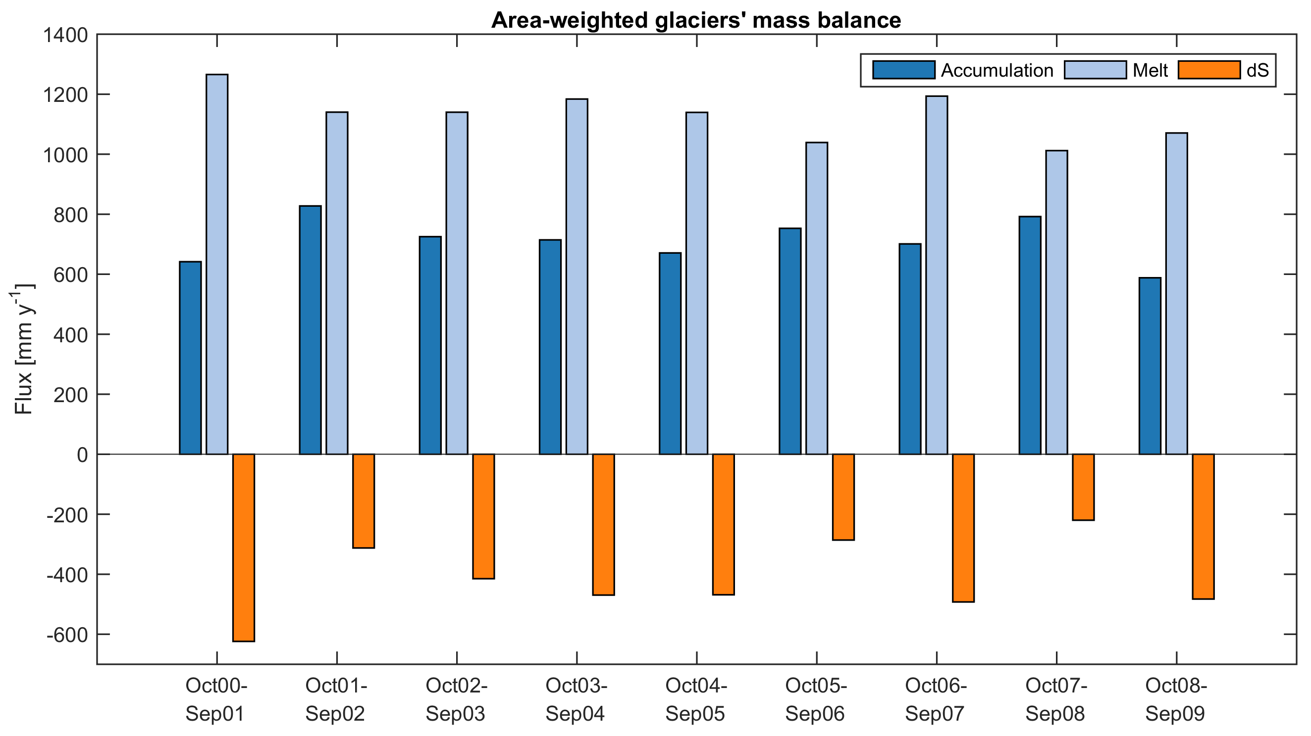
dS = -391 mm y⁻¹

Slide 10
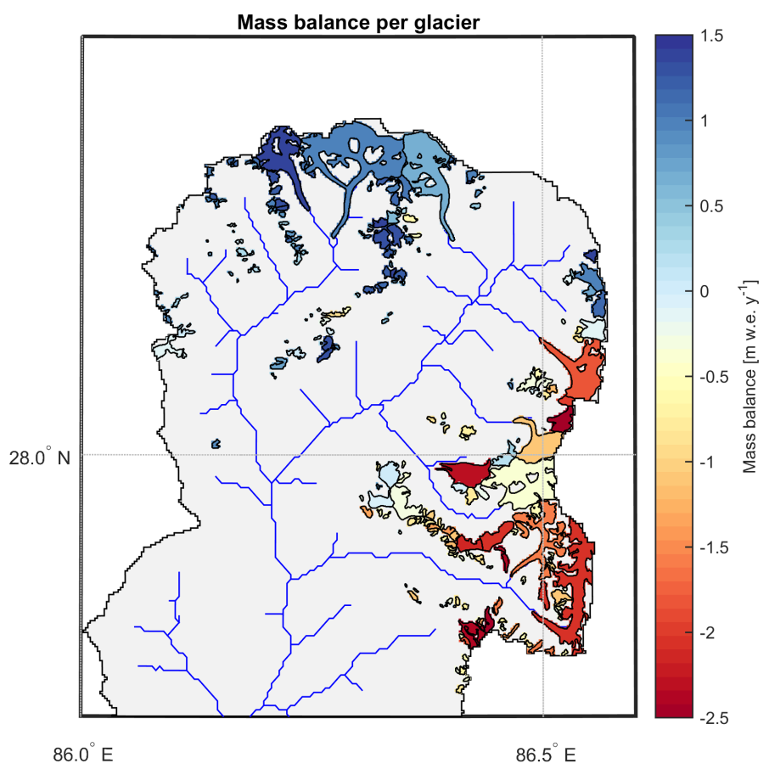

Slide 11
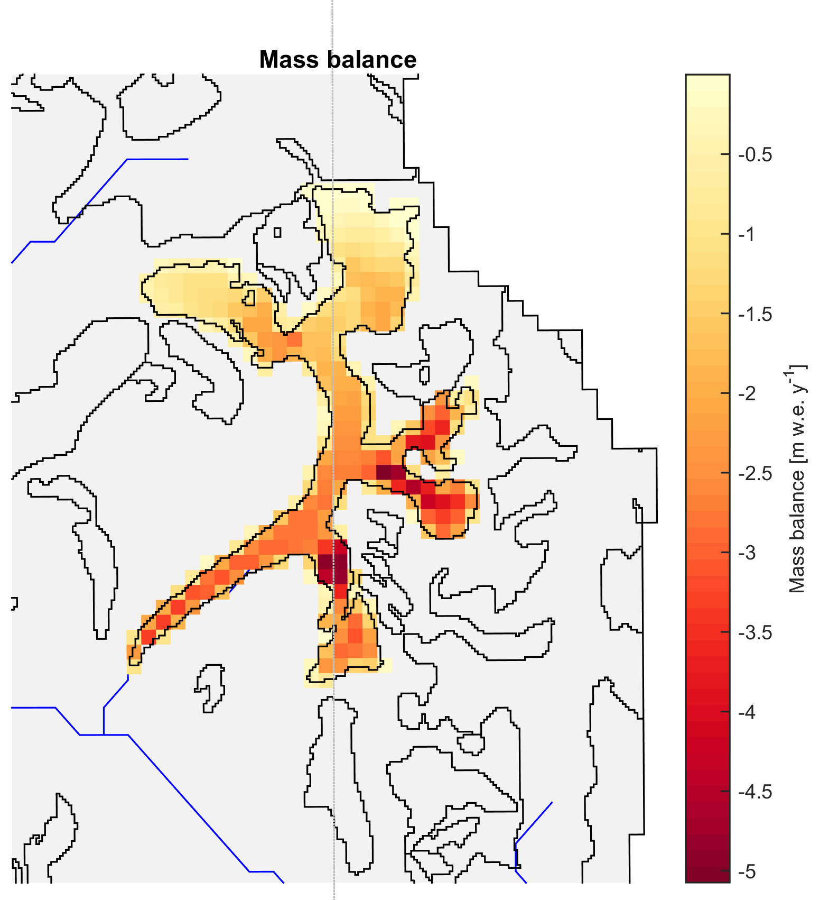
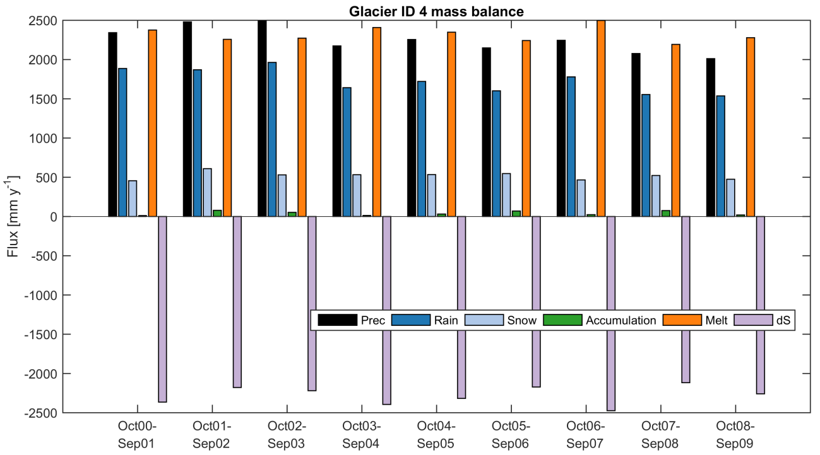

Slide 12
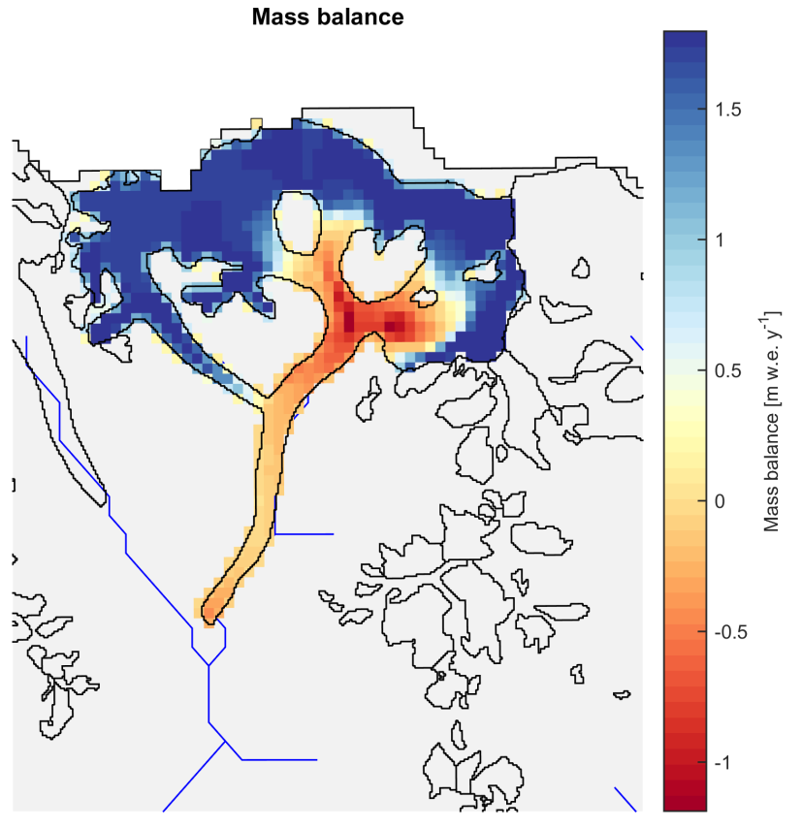
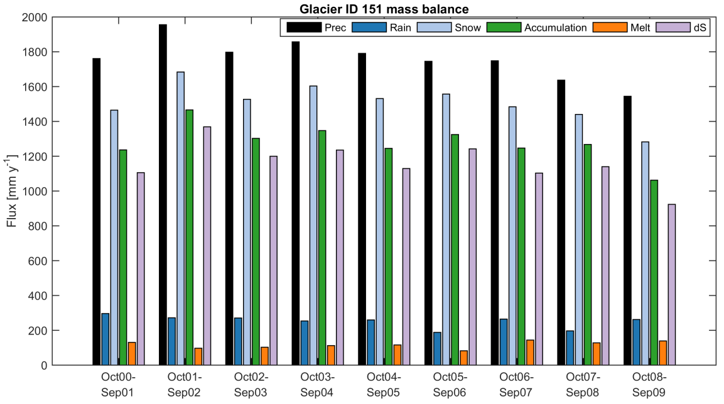

Slide 13
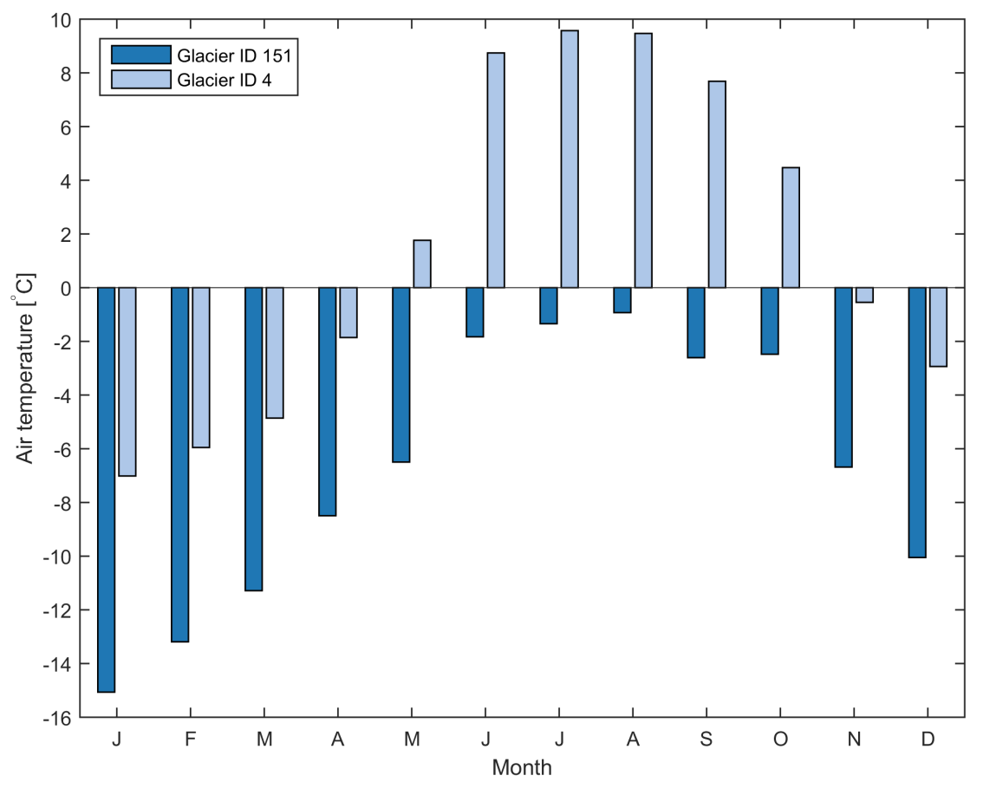

Slide 14
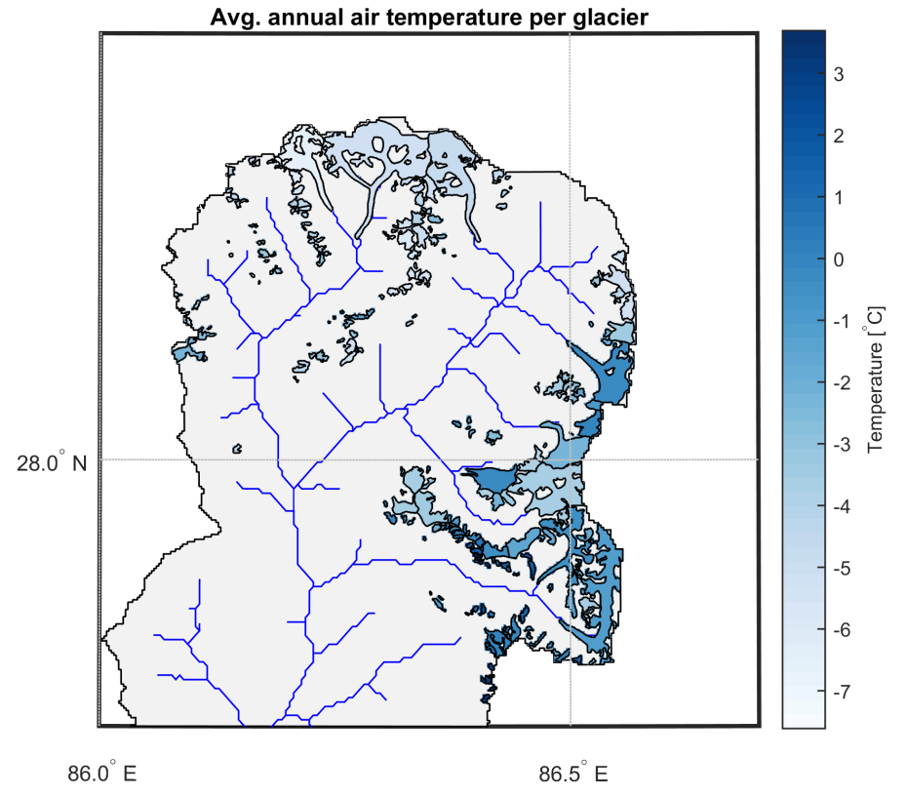
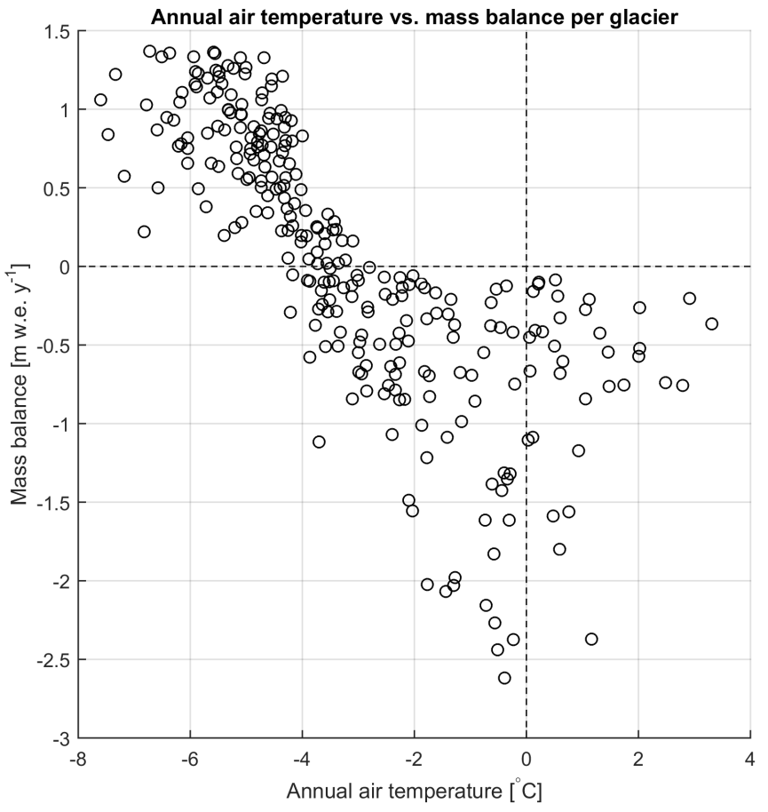

Slide 15
Conclusions and shortcomings
Conclusions:
SPHY glacier module now mass conserving
Mass transport from accumulation to ablation zone included
Scale independent and suitable for medium to large river basins
Model calibration matches annual glacier mass balance
Shortcomings:
Less applicable for very large model resolutions (no ice redistribution)
Only ice redistribution if glacier has negative mass balance
Glaciers cannot increase in area

Slide 16
Thank you
Email: terinkw@gmail.com

